Slide 1
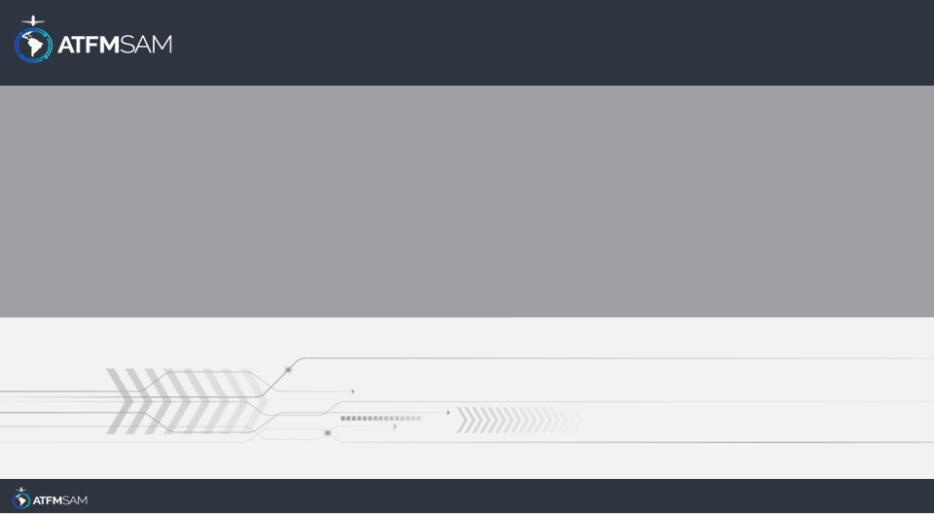
PDA - CGNA
18/04/2026

Slide 2
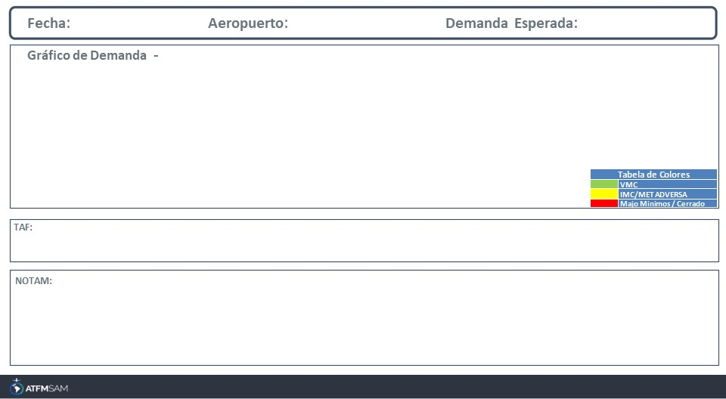
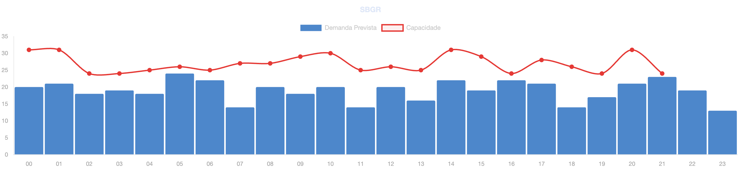
18/04/2026
SBBR
BAJA
Mañana | Tarde | Noche
TAF SBBR 171600Z 1718/1818 10010KT 9999 SCT035 TX27/1718Z TN19/1809Z TEMPO 1718/1721 07004KT SCT035 FEW045TCU BECMG 1722/1724 12007KT CAVOK BECMG 1802/1804 VRB02KT TEMPO 1805/1808 30003KT BECMG 1808/1810 10010KT BECMG 1813/1816 SCT035 TEMPO 1816/1818 VCSH BKN030 FEW040TCU RMK PGQ

Slide 3
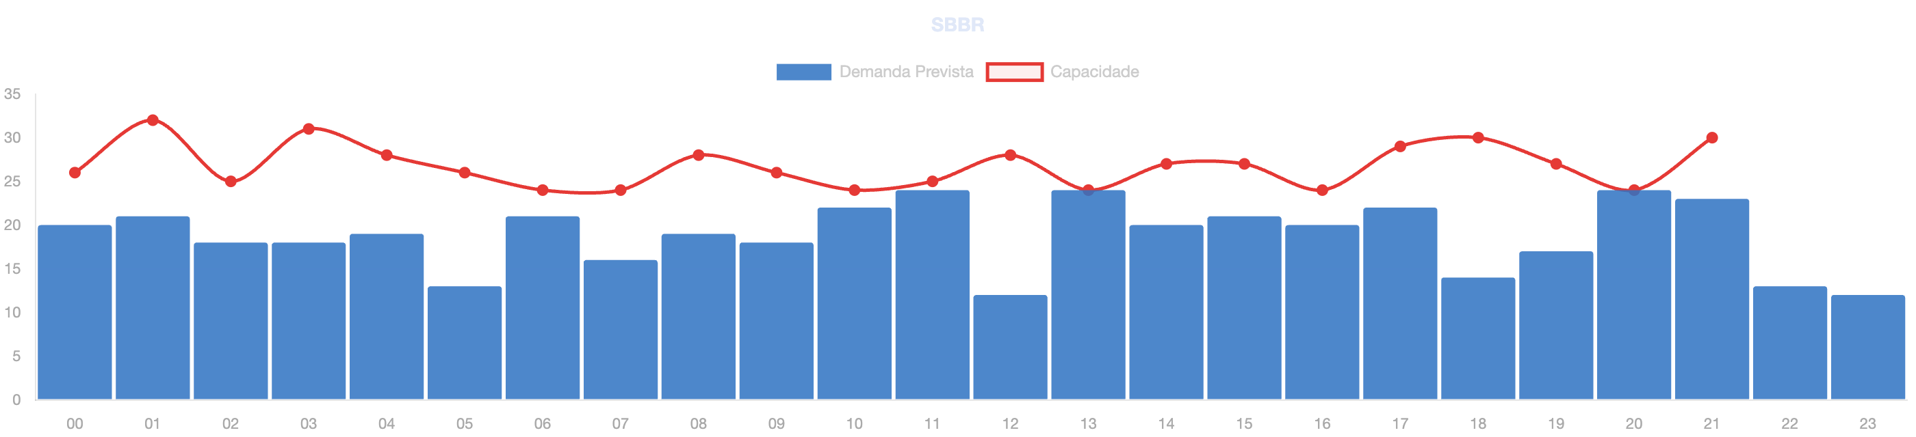
18/04/2026
SBGL
BAJA
Mañana | Tarde | Noche
TAF SBGL 171530Z 1718/1824 14010KT 9999 FEW030 TN22/1809Z TX33/1815Z BECMG 1722/1724 11005KT BECMG 1801/1803 06005KT BECMG 1805/1807 33003KT BECMG 1812/1814 05006KT BECMG 1816/1818 14010KT BECMG 1823/1824 11005KT RMK PFV

Slide 4
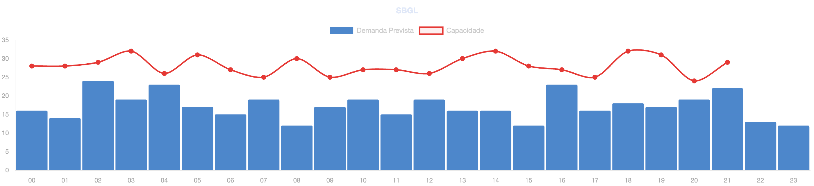
18/04/2026
SBGR
BAJA
Mañana | Tarde | Noche
TAF SBGR 171630Z 1718/1824 34005KT 9999 FEW035 TX30/1718Z TN17/1809Z BECMG 1720/1722 11005KT BECMG 1801/1803 08005KT 7000 FEW016 BECMG 1808/1810 06007KT BECMG 1812/1814 34007KT 9999 FEW040 BECMG 1815/1817 29006KT PROB30 1818/1820 VCSH BECMG 1820/1822 16005KT 8000 SCT016 RMK PGM

Slide 5
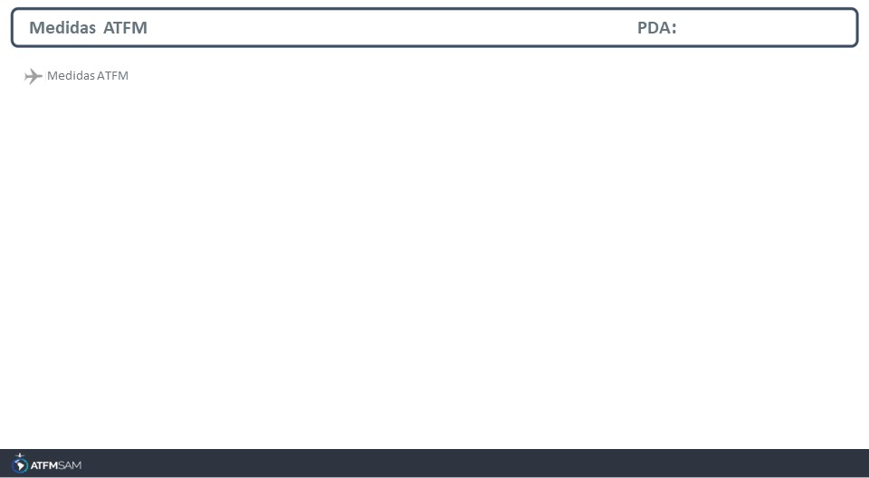
STATE | ORIGIN | DESTINY | ER | START | MEASURE | REASON

Slide 6
